Slide 1


Applications Programming: Assignment 1

Slide 2


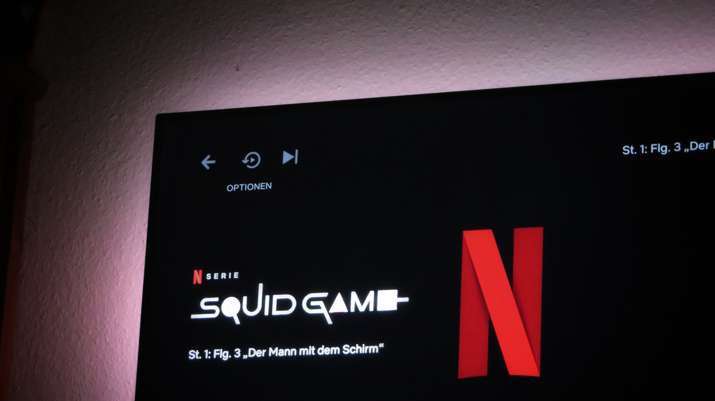
Another Squid Game!
A text-based role playing adventure game based on Netflix's 'Squid Game'

Slide 3

Overview
Notes:
Overview of the game!

Slide 4
Game starts with character creation. User can choose one from three super-powers which are 'Enhanced Vision', 'God Reflexes' and 'Super Strength' for his character.
Split into three levels (stages) which are 'Maze Escape', 'Stepping Glass Stones' and 'Rock, paper, scissors'.
Gameplay includes 4 players including one user and three bots.
Every super-power has its own advantages over others, in a particular level (stage).
Players will be eliminated at the end of each level, hence, the last man standing wins the game.
Notes:
So, the game starts with character creation.
User can choose one from three super-powers which are 'Enhanced Vision', 'God Reflexes' and 'Super Strength' for his character.
The game is split into three levels (stages) which are 'Maze Escape', 'Stepping Glass Stones' and 'Rock, paper, scissors'.
The game starts with four players including one user and three bots.
Every super-power has its own advantages over others, in a particular level (stage).
Players will be eliminated at the end of each level, hence, the last man standing wins the game.

Slide 5

Game Stages
Notes:
Game stages!

Slide 6
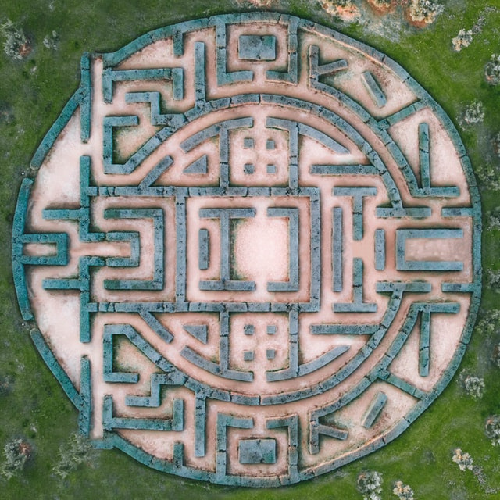
The Maze Escape
This is the first stage of the game. Four players will be put into a maze. The goal is to escape the maze, by analyzing hints from the surrounding. Players who won't be able to escape the maze will be eliminated.
Notes:
This is the first stage of the game. Four players will be put into a maze. The goal is to escape the maze, by analyzing hints from the surrounding. Players who won't be able to escape the maze will be eliminated.

Slide 7

Glass Stepping Stones
It is the second stage of the game. Players will have to cross a bridge made of glass panels. Task is to make a way safely across the bridge, choosing from the left or right panel at each step.
Notes:
It is the second stage of the game. Players will have to cross a bridge made of glass panels. Task is to make a way safely across the bridge, choosing from the left or right panel at each step.
This stage is like the game shown in the TV show 'Squid Game'

Slide 8

Rock, Paper, Scissors
It is the final stage of the game. Players will have to play a simple game of rock, paper, scissors. Those who lose are eliminated. Winner of this stage wins the game.
Notes:
It is the final stage of the game. Players will have to play a simple game of rock, paper, scissors. Those who lose are eliminated. Winner of this stage wins the game.

Slide 9

Why 'Another Squid Game'?
Notes:
Why I chose to build 'Another Squid Game'?

Slide 10

Trending on Netflix
According to collider.com, Squid Game is one of the top 10 trending shows on Netflix, as of October 2021
Source: https://collider.com/top-10-netflix-tv-shows-list/
Notes:
One of main reason is that the TV show 'Squid Game' is one of the top trending shows on Netflix.
I found this information on collider.com.

Slide 11

Popular among young adults
As theTV show is popular among young adults, they would love to play 'Another Squid Game'.
Notes:
As the TV show is popular among young adults, they would love to play 'Another Squid Game'.

Slide 12
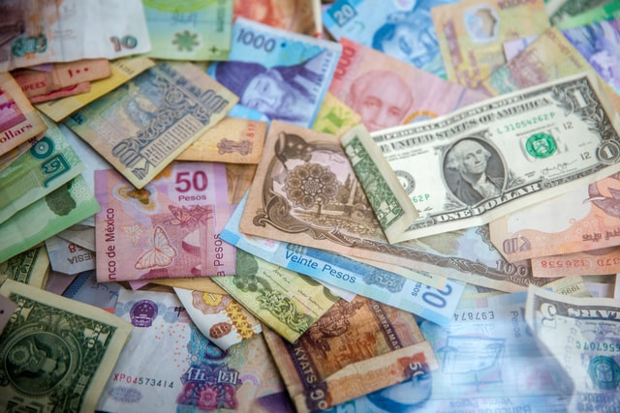
Easy to Sell
'Another Squid Game' will be easy to sell to the investors or game publishing companies, because of the popularity of squid game.
Notes:
And because the TV show is popular it will be easy to sell to the investors or game publishing companies.

Slide 13
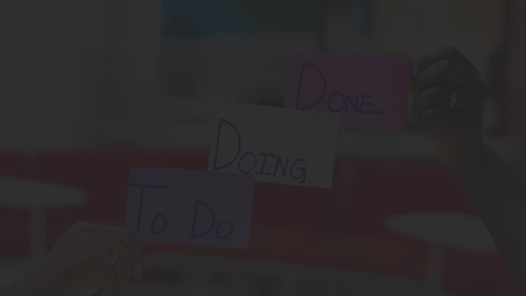
Agile Feature Driven Development
Notes:
So, talking about the development part, I have chosen Feature Driven Development to build this game.

Slide 14
FDD is an iterative model for developing software. It focuses on:
Developing overall model
Feature Driven Development
Building a features list
Plan by those features
Design by those features
Build by those features
Notes:
FDD is an iterative model for developing software. It focuses on:

Slide 15
Design high-level model
Develop features list
Feature Driven Development
Iterate after feedback
Plan by feature
Design by feature
Build by feature
Notes:
Here is a basic flowchart for the process.
At first, we design the high-level model of the software.
Then, we list down all the features of the software.
After that, we plan those features.
Then, we develop the software development feature-by-feature.
If something goes wrong or any feedback is inputted, we reiterate the process for that particular feature.

Slide 16
Easier to track and fix coding errors
Why use Feature Driven Development?
Allows you to make a quick turnaround
Highly scalable
Minimal Complexity of the System
Maximum Quality
Notes:
I chose FDD because,
I am planning to build this game level-by-level, so, it will be easier to track bugs.
It will allow me to scrap the bad code and redevelop code for a particular level or feature.
And at last, FDD is highly scalable, and it involves minimum complexity of the system.

Slide 17

Project Stakeholders
Notes:
Project stakeholders!
So, stakeholders are the people who are affected by a software development project.
Stakeholders are categorized into two categories which are -
primary stakeholders and secondary stakeholders.

Slide 18

Primary Stakeholders
Customers (Video game Publishers) like -
Activision Blizzard
Tencent Games
Developer and tester (me)
Notes:
Primary stakeholders for my game would be the game publishing companies like Activision Blizzard, Tencent Games and also me because I will be developing and testing it.

Slide 19

Secondary Stakeholders
Competitors (Other video games) like -
Zork
GTA V
End-users (Target audience) -
Teenagers and young adults
Gen X video game players
Notes:
Secondary stakeholders will be the competitors, mostly other video games like Zork which a text-based RPG game and also the users of my game.

Slide 20

User Persona
Notes:
User persona!

Slide 21

ABOUT
John is a high school student at Norwich school. In his free time, he watches Netflix and plays video games. He wants to be popular in school.
AGE 17
OCCUPATION Student
LOCATION Norwich, UK
INCOME Nill
NEEDS
FRUSTATION
Trending video games and Netflix shows.
New friends and popularity in school.
Hard time finding unique video games and TV shows.
Feels devalued and unimportant because nobody listens.
FAVORITE VIDEO
GAMES
FAVORITE TV SHOWS
& MOVIES
John Doe
GTA V
Zork
Far Cry 5
Squid Game
Money Heist
Dune
"I am really interested in watching TV, playing video games."
Notes:
Persona is basically the user for whom my game is made.
So, the target audience for my game will be teenagers who go to high school and love to watch Netflix and play video games.
I have named the persona as John Doe, his is 17, and from Norwich.
He wants to be popular in school. He is in constant search for new TV shows and video games, so that he could talk to his friends about it.
He is frustrated when anyone ignores him and when he is unable to find unique video games or TV shows.
His favorite video games are GTA V, which is a RPG, Zork, a text-based RPG and Far Cry.
His favorite TV shows are Squid Game and Money Heist.

Slide 22

User Empathy Map
Notes:
Empathy map of John Doe.

Slide 23
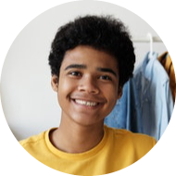
THINK & FEELS
What's current favourite TV show?
Which is the most played video game?
Feel like an insider, always excited
SEES
HEARS
Classmates discussing about their favourite video games.
Watches Netflix.
Gameplay videos on YouTube.
"Squid is the best TV show!"
"Have you played Zork? It's cool."
"You haven't watched GOT? OMG!"
SAYS & DOES
"Squid is the best TV show!"
"I like adventure games"
Searches for new video games.
PAIN
GAIN
Hard time finding unique RPG game.
Everyone is bored of 'Squid Game' discussions.
Finds a unique RPG game based on his favorite TV show.
Talks about the game with others.
Notes:
So, John constantly thinks about his favorite TV show, popular video games and he is always excited and feels like an insider.
He hears that Squid game is the best TV show, Zork game is cool and stuff like that.
He sees people around him talk about TV shows and video games. He watches Netflix and gameplay videos on YouTube.
He says that he likes adventure games and agrees that Squid Game is the best TV show.
He searches for new video games in his spare time.
His pain points are that it is tough to find unique RPG games, and everyone is bored of Squid Game discussions, he wants something new related to his favorite TV show.
If he is introduced to the game which I am developing he is definitely going to try it and he will be sharing it with others.

Slide 24
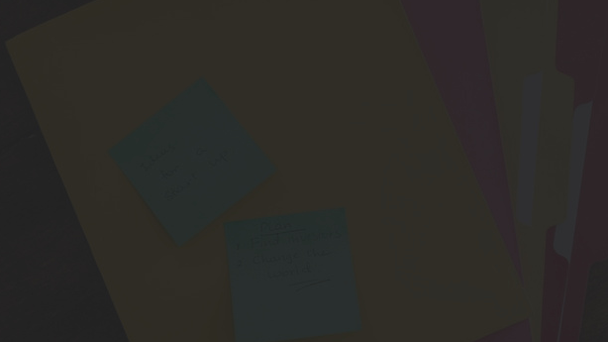
MoSCoW analysis of the Software
Notes:
MoSCoW analysis!

Slide 25
MUST HAVE
SHOULD HAVE
More than one characters.
Multiple levels (stages).
Character creation.
Super-powers to all the characters.
Every super-power will have it's advantages over the other in different levels (stages) of the game.
Save and continue functionality.
Document based database.
COULD HAVE
WON'T HAVE
Suspense/thriller music in the background.
2D graphics for character creation.
More levels and characters.
Multiplayer functionality.
AI for bots.
3D graphics.
Server based Database.
Notes:
MoSCoW analysis, is a popular prioritization technique for managing requirements in the software.
The acronym MoSCoW represents four categories of initiatives: must-have, should-have, could-have, and won't-have right now in the software.
So, my game

Slide 26

Software Dependencies
Notes:
Software Dependencies!
While developing the game, we will be needing a few open source libraries like

Slide 27

Storage Library: TinyDB
TinyDB is a lightweight document oriented database. It’s written in pure Python and has no external dependencies. It will be used for saving user data and to achieve multi-user functionality.
Source: https://pypi.org/project/tinydb/
Notes:
Like TinyDB, it is a used for key-value based storage of data. This will help in achieving the multi-user functionality in the game.

Slide 28

Audio Library: Playsound
Playsound library can be used to play audio in the background to give user an immersive experience.
Source: https://pypi.org/project/playsound/
Notes:
Another is a sound player library called 'playsound'. It will be used for playing suspense or thriller music in the background to give an immersive experience to the user.

Slide 29

2D Graphics Library: Turtle
Turtle graphics can be used to create 2D faces while creating character in the game.
Source: https://docs.python.org/3/library/turtle.html
Notes:
A 2D graphics library called 'Turtle' will be used to create 2D faces in character creation part of the game.

Slide 30

Library for Text Color: Colorama
Colorama can be used to change the color of the text in terminal according to the game scenario to give an immersive effect.
Source: https://pypi.org/project/colorama/
Notes:
Also, a text color library called 'Colorama' will be used to change the color of the text in terminal. So, for example if a player is eliminated the message will be shown in red color. This will provide an immersive experience to the user.

Slide 31

System Use Case Diagram
Notes:
Use case diagram for the system!

Slide 32
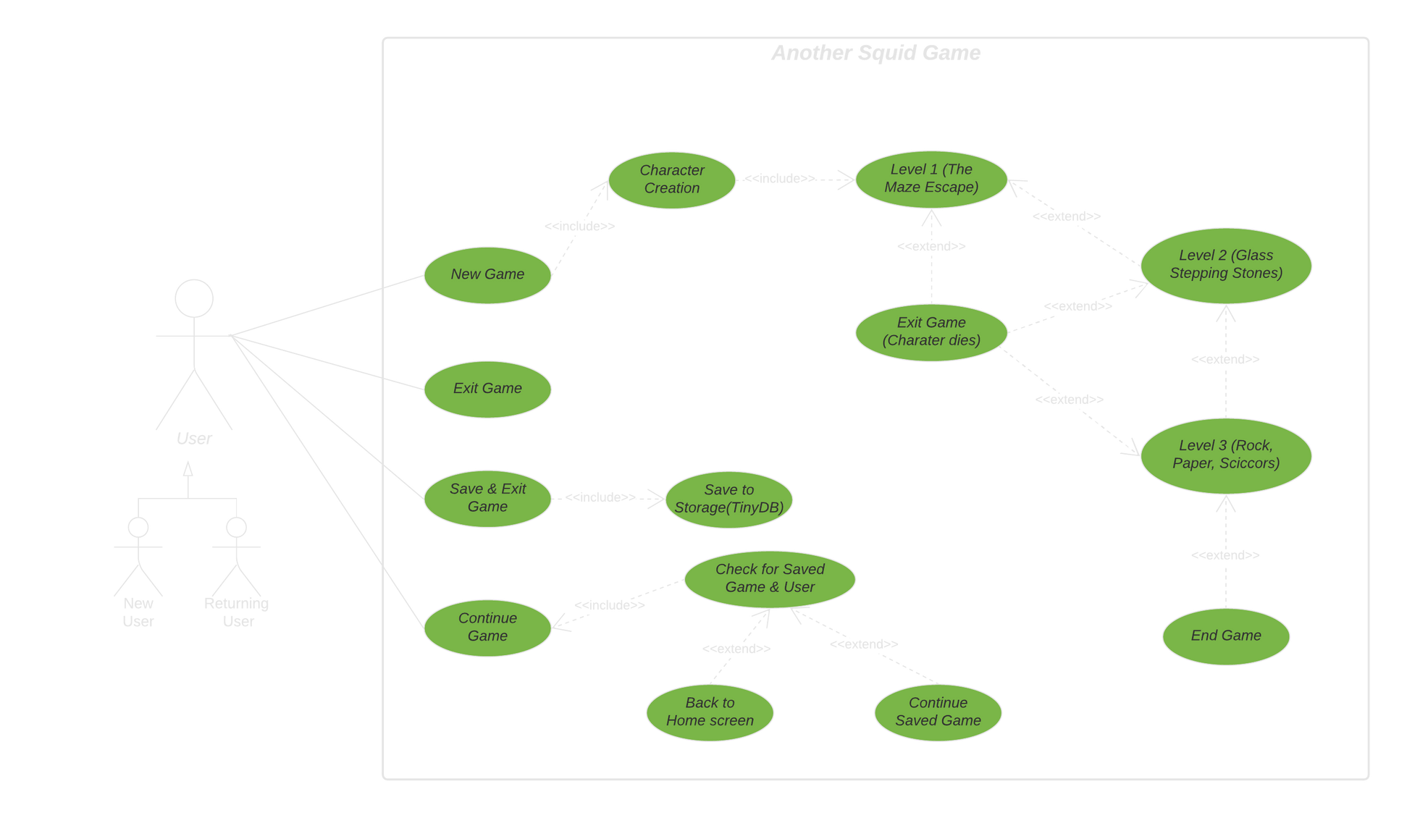
Notes:
So, the game represented by the big rectangle in white, it the scope of the system everything inside it happens inside the system, anything outside it not a part of the system.
The three stick figures are called actors. The actors will be the users of the game. Users are categorized into new users and returning users.
There are four main use cases in the system which are New Game, Exit Game, Save & Exit Game and Resume Game.
Use case represents an action within the system.
There is an association relationship between the user and the four main use cases which is showed by solid straight lines.
When a user starts a new game, he is taken to character creation part of the game. Character creation use case is dependent on New Game use case so it is called an include relationship. When the user is playing a level he might get eliminated or advance ahead. For example if he is at level one he may get eliminated and the game will exit, so the level 1 use case and exit game use case has an extend relationship as shown in the diagram.

Slide 33

Textual Use Case: Resume Game
Notes:
Textual use case for resume game!

Slide 34
Use Case Name: Resuming Game
Goal in context: Enabling user to resume game from last saved checkpoint
Scope & Level: Should have
Pre-Condition: Nill
Success-End Condition: Game is resumed from last saved checkpoint
Failed-End Condition: User is redirected to the homescreen
Actor: User
Trigger: User types in 'Resume Game' or corresponding number in terminal
Notes:
So the goal is to enable the user to resume game from last saved checkpoint. There are no pre-conditions.
The trigger point for this event is when the user types in 'Resume Game' in the terminal.

Slide 35
cont.
User types in 'Resume Game' or corresponding number in the terminal.
User types in his username.
System searches for the user and saved game in system storage.
Username and saved game found in the system.
Success message is shown.
Game resumes from the last saved checkpoint.
Successful Path:
Unsuccessful Path:
User types in 'Resume Game' or corresponding number in the terminal.
User types in his username
System searches for the user and saved game in system storage.
4a. Username not found.
4b. Username found but saved game not found.
6. Error message is shown.
5. User is redirected to the homescreen
Notes:
Here are the successful and unsuccessful paths for the event.
When it is successful game is resumed and when it is not the user is redirected to the home screen and shown an error message.

Slide 36
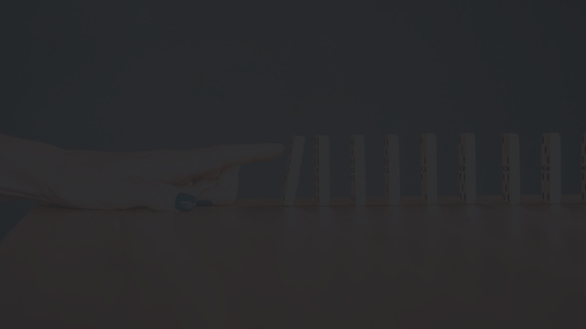
Sequence Diagram: Resume Game

Slide 37
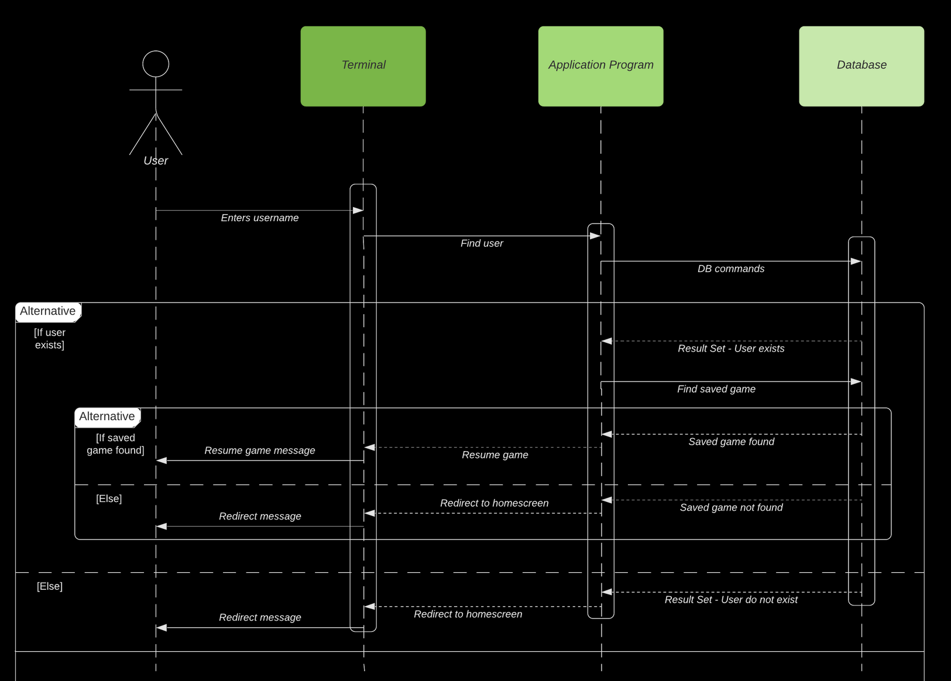
Notes:
Sequence diagrams describes how—and in what order—a group of objects works together.
Describe it first.
As we can see from the diagram, for this process the database of the system is approximately as active as the application program itself, as there are a lot of read operations.

Slide 38
Activity Diagram: Resume Game

Slide 39
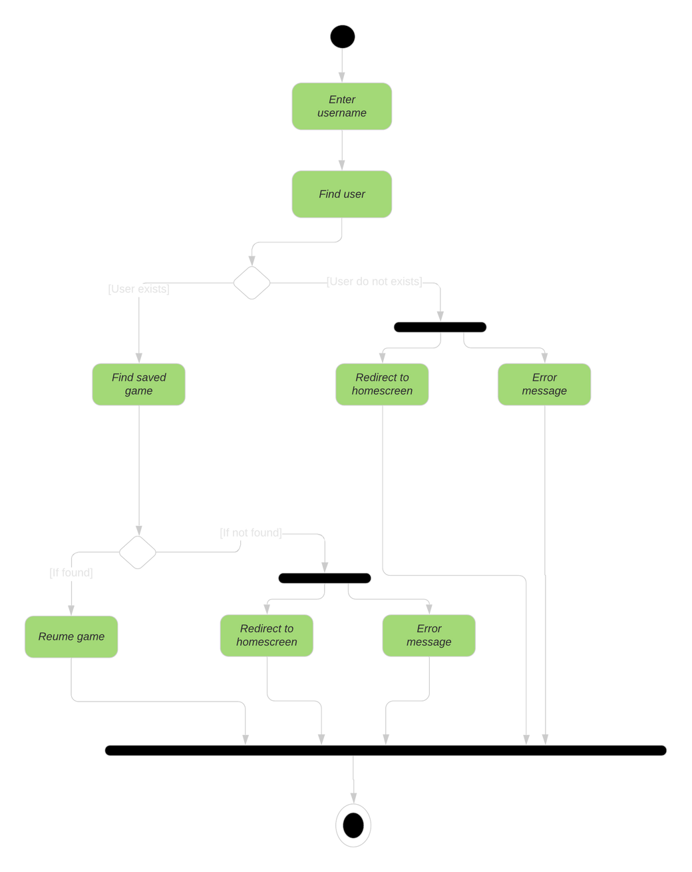
Notes:
So here is the activity diagram for the same process.
Activity diagrams represents the flow control among the activities in the system.
The black dot at the top is start node and the black dot surrounded by an outline is the stop node. This is where the flow terminates.
Rounded rectangles are the activity symbols which represents different activities.
Solid lines with arrows are called control lines, directing the flow of activities.
Diamonds represents the conditions.

Slide 40

Thank you!

